Slide 1
The NMU College of Business

Slide 2
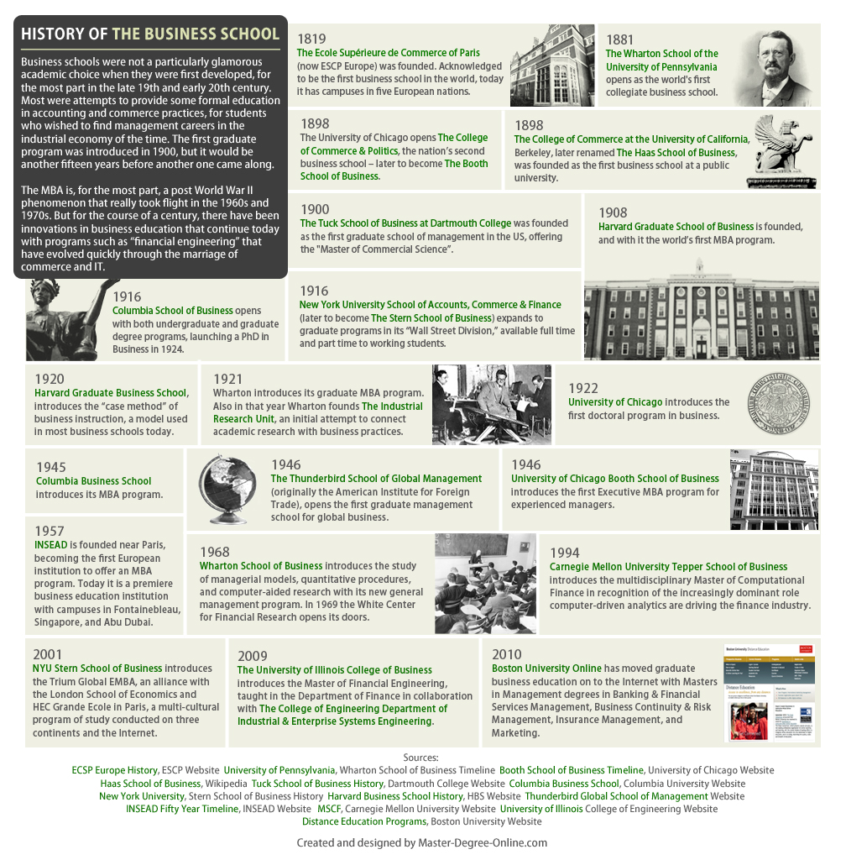
The Future of business schools

Slide 3
The NMU College of Business
1914 – Business Education Class
1933 – Department of Commerce
1966 - School of Business Management
1967 – Walker L. Cisler School of Business Management
1969 – First Dean appointed (Don Hangen)
1990-1991 – Named a College (appears in the 1992-1993 directory)
1996 – Organized as a College of a Whole
2002-AACSB Accreditation
2015-Faculty voted to reorganize as two departments in the college

Slide 4
The NMU College of Business
Mission of the COB
The mission of the College of Business is to engage students with relevant academic and related programs that prepare them for a variety of successful careers and responsible engagement in society.
Adopted February 24, 2012
Vision of the COB
By 2016, the College of Business at Northern Michigan University will be the college of choice for business education in the region.
Adopted February 24, 2012 (both currently under review)

Slide 5
The NMU College of Business
College Enrollment and Faculty Staffing and Sufficiency

Slide 6
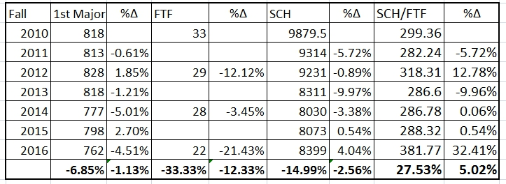
The NMU College of Business

Slide 7
The NMU College of Business
Faculty Productivity

Slide 8
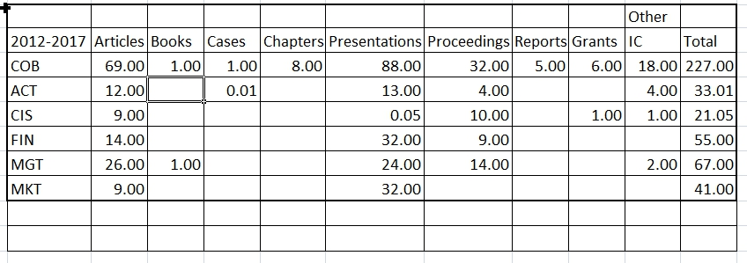
The NMU College of Business

Slide 9
The NMU College of Business
Financial Performance

Slide 10
The NMU College of Business

Slide 11
The NMU College of Business
Accreditation

Slide 12
The NMU College of Business

Slide 13
The NMU College of Business
Michigan: Eastern Michigan University, Central Michigan University, UM Dearborn, Northern Michigan University, UM Flint, University of Michigan, Michigan State University, Michigan Tech, Western Michigan University, Oakland State University, Wayne State University, Grand Valley State University, UD Mercy, Saginaw Valley State University

Slide 14
The NMU College of Business
Wisconsin: UW Whitewater, UW Madison, UW Oshkosh, UW River Falls, UW Parkside, UW Eau Claire, UW La Crosse, Marquette University

Slide 15
The NMU College of Business
93% of business schools worldwide DO NOT have this accreditation!

Slide 16
The NMU College of Business
Innovation
Impact
Engagement
Experiential Learning

Slide 17
TeAM Business

Slide 18
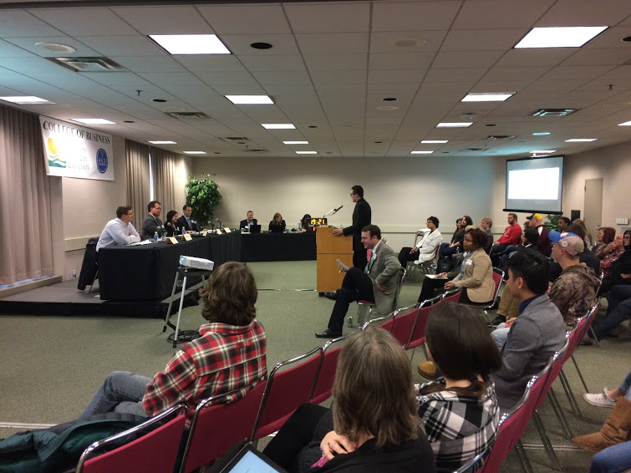
New Venture Business Competition

Slide 19
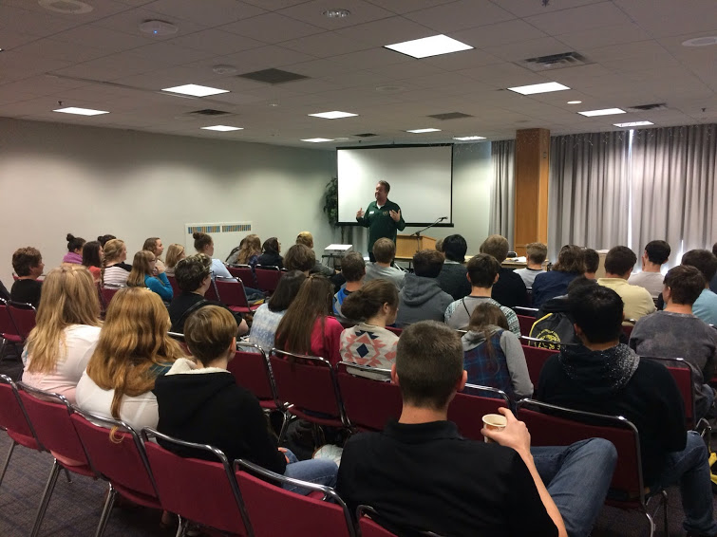
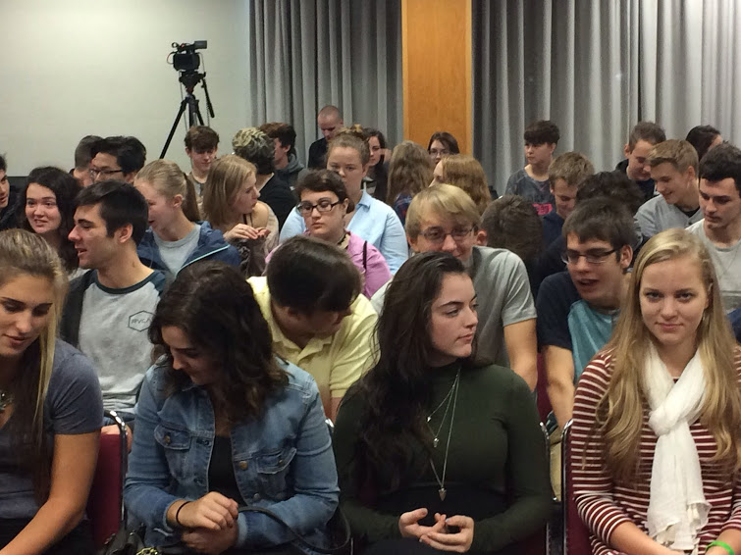
Celebration of Entrepreneurship

Slide 20
Social Events - Social Mixers Speed interviewing Industry panel Luncheons Executive in Residence Mentors Internships

Slide 21
The NMU College of Business
Business Innovation Center
College of Business
Northern Initiatives
Invent@NMU
Innovate Marquette
The Center for Rural Community and Economic Development

Slide 22
The NMU Business Innovation Center

Slide 23
The NMU Business Innovation Center

Slide 24
The NMU Business Innovation Center

Slide 25
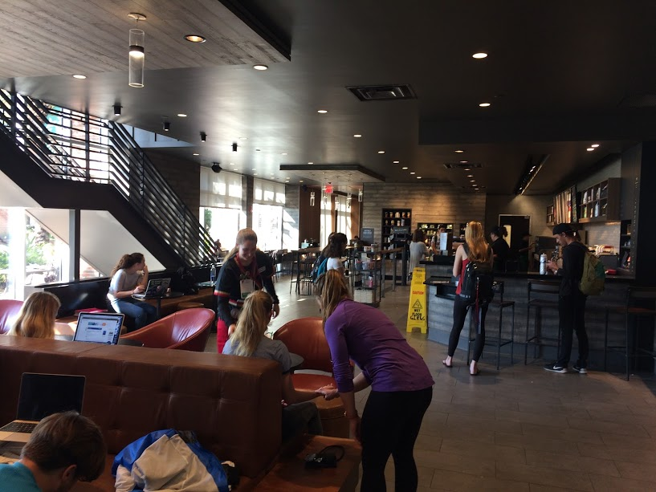
The NMU Business Innovation Center

Slide 26
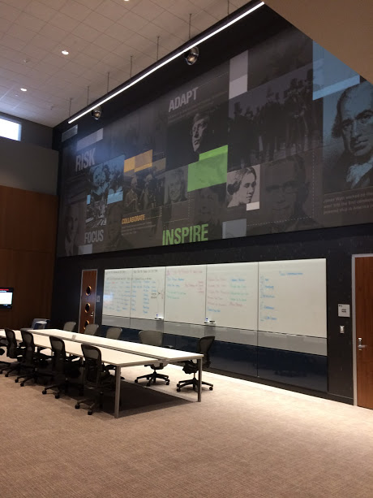
The NMU Business Innovation Center

Slide 27
The NMU Business Innovation Center

Slide 28
The NMU College of Business
WHY?

Slide 29
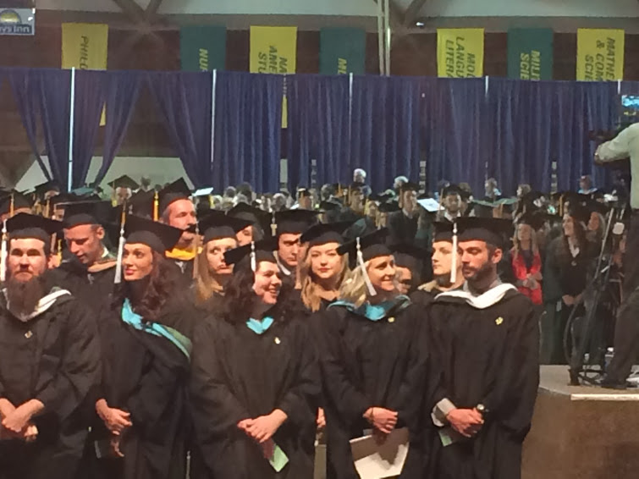
The NMU College of Business
7,000 Alumni Around the World!

Slide 30
The NMU college of Business Our Goal
“The school of the future will not be a place. It will consist of multiple interconnected locations around the world. Individuals will not go to school, they will join a network … for life long learning and contact building.” (Hawawini, 2005)

Slide 31
The NMU College of Business
Challenges/Opportunities
Faculty Shortages
Faculty Costs
Shared Governance
Curriculum
Sophisticated Students
Funding
Globalization
Technology
Transnational Models
Economic Regeneration
Local Impact
Business as a Force for Good
Value

Slide 32
The Future of business schools
Strategies For The Future
Collegiality
Innovation
Distinctiveness
Entrepreneurial
Engagement
Experiential Pedagogy
Impact

Slide 33
The NMU College of Business
Sources
Acito, Paul, Patricia McDougall, Daniel Smith, “One Hundred Years of Excellence in Business Education: What Have We Learned?” Business Horizons, 51, 2008, 5-12.
Clark, Dorie, “What the Future of Business Education Looks Like,” Forbes, 9/12/2012.
Future Index, “Boom or Bust,” July 19, 2013.
Harvard Magazine, “Three Stonecutters: On the Future of Business Education,” 10/15/2008.
Hawawini, Gabriel, “The Future of Business Schools,” The Journal of Business Management, 24:9, 2005, 770-782.
http://theexchange.aacsb.edu/Home/, AACSB International, 2014, Tampa, FL, 33602.
Kuratko, Donald, “Entrepreneurship Education: Emerging Trends and Challenges for the 21st Century,” 2003 Coleman White Paper Series for the U.S. Association on Small Business and Entrepreneurship.
Kuratko, Donald, “The Emergence of Entrepreneurship Education: Development, Trends, and Challenges,” ET&P, 2005, Baylor University, 577-597.
Onzono, Santiago Liniguez de, “The Changing Model of Business Schools,” The Journal of Management Development, 26:1, 2007, 22-32.
Shoemaker, Paul, “The Future Challenges of Business: Rethinking Management Education and Research,” California Management Review, 50:3, Spring, 2008, 118-139.
Viewpoint, “Can Business Schools Meet the Challenge of the Future?” IMD, 6/27/2013.
http://www.nmu.edu/business/node/13, Northern Michigan University, 2014, Marquette, MI 49855.

