Slide 1
Technology and Occupational Sciences (TOS)
Enhancement Position

Slide 2
Brief Overview of the Department
9 program areas
Electrical Line Technician (1 yr - Diploma)
Welding (1 yr – Certificate)
Cosmetology (2 yr – Certificate)
Aviation Maintenance (A.A.S.)
Automotive Service (A.A.S.)
Climate Control – HVACR (A.A.S.)
Industrial Maintenance (A.A.S.)
Construction Management (B.S.)
Hospitality Management (B.S.)
22.4 Full Time Equivalent faculty (19 faculty, 9 adjuncts)
585 majors
12,505 SCH, 2010-11

Slide 3
TOS Enrollments

Slide 4
TOS Program Enrollments/Faculty
2 3 3 2 2 2 4 .5 .5
Full Time Faculty

Slide 5
Industrial Maintenance / Welding Programs
1. Alignment with the Mission & Vision of Academic Affairs
Intellectual foundation in the theory of manufacturing processes, equipment & facilities
Design, layout, problem solving, trouble shooting, critical thinking & root cause analysis
Active learning
lab experiences in most of the classes
Internships
Career preparation
Mining, Shipbuilding and Manufacturing Industries
Community Involvement
Benches for downtown Marquette
Dace Darter Memorial – Marquette Maritime Museum
Miscellaneous welding work

Slide 6
Industrial Maintenance / Welding Programs
2. History, development and expectations of the program
An outgrowth of Cliffs Natural Resources (CNR) on-the-job apprenticeship program for Maintenance Mechanics.
The IM program was implemented around 1999
Recent changes include:
Addition of IM215 – Advanced Mechanical Power Transmission Systems – 3 credits
A proposal is currently at the Academic Senate to add 1 lab credit to each:
IM110 – Industrial Measurement & Fabrication
IM214 – Alignment, Power Transmission and Conveyors.
This will add an additional 48 hours of hands on work to the IM program

Slide 7
Industrial Maintenance / Welding Programs
3. External Demand for the Program
Industrial Maintenance and Welding graduates are in high demand in the Midwest Region
CNR
Marinette Marine
Systems Control (Boss Snowplow)
Kennecott
Oldenburg Corporation
Saw mills
Paper mills

Slide 8
Industrial Maintenance / Welding Programs
4. Internal Demand for the program
The Industrial Maintenance minor is popular (9)
Some of the welding courses serve in other majors, Art & Design – Jewelry, Metalsmithing & Blacksmithing
Many IM/WELD classes are taken as general electives

Slide 9
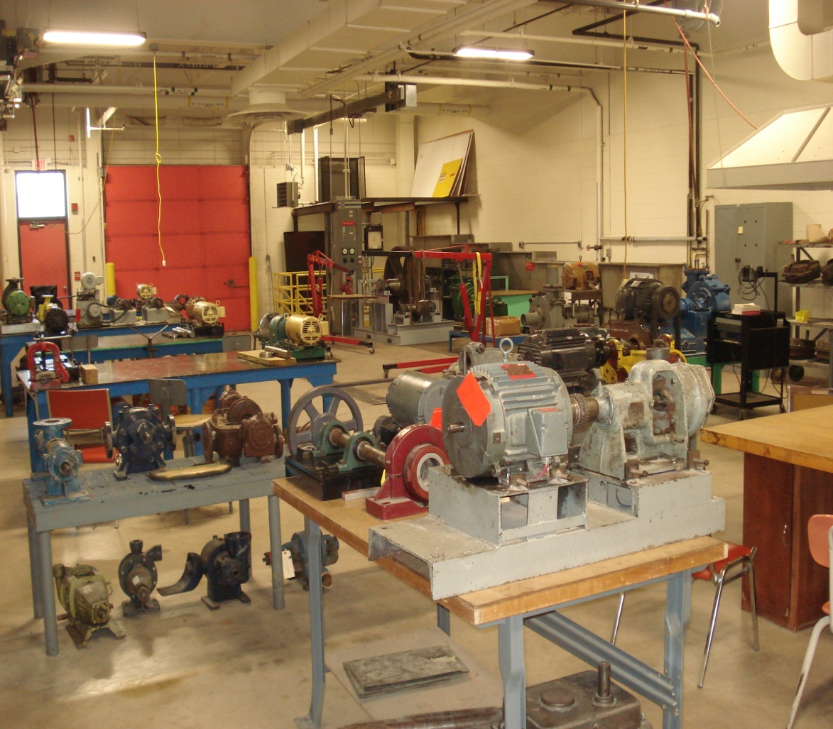
Industrial Maintenance / Welding Programs
5. Quality of Program Inputs and Resources
Fully qualified faculty
The Industrial Maintenance laboratory recently moved from a shared space to dedicated lab space in January 2011.
In conjunction with the move, new and used equipment donations from CNR, WE Energies and Motion Industries in the form of gear boxes, electric motors and air compression systems greatly improved the quality and quantity of available lab equipment.

Slide 10
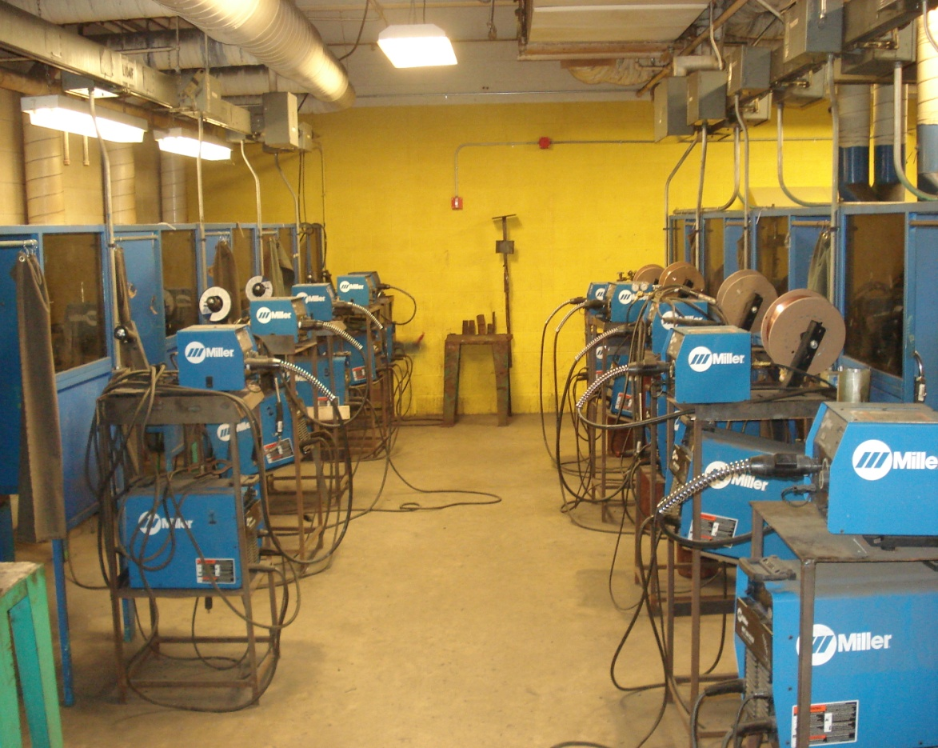
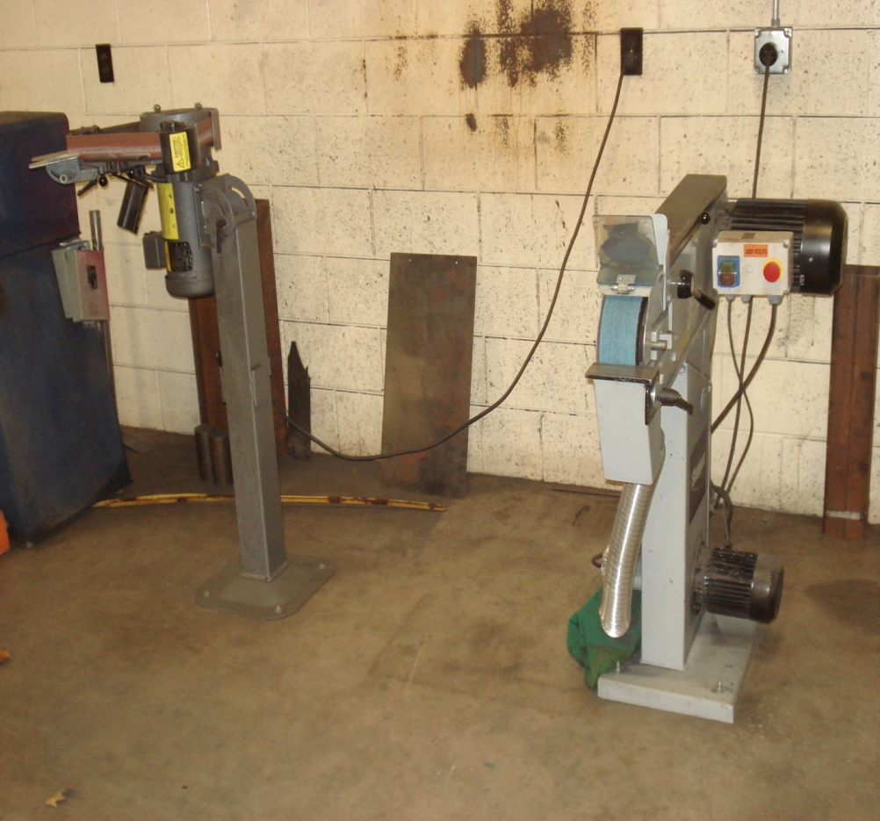
Industrial Maintenance / Welding Programs
5. Quality of Program Inputs and Resources
In the Welding lab, equipment has been incrementally updated over the past four years with new energy efficient technology that can also provide more welding applications.

Slide 11
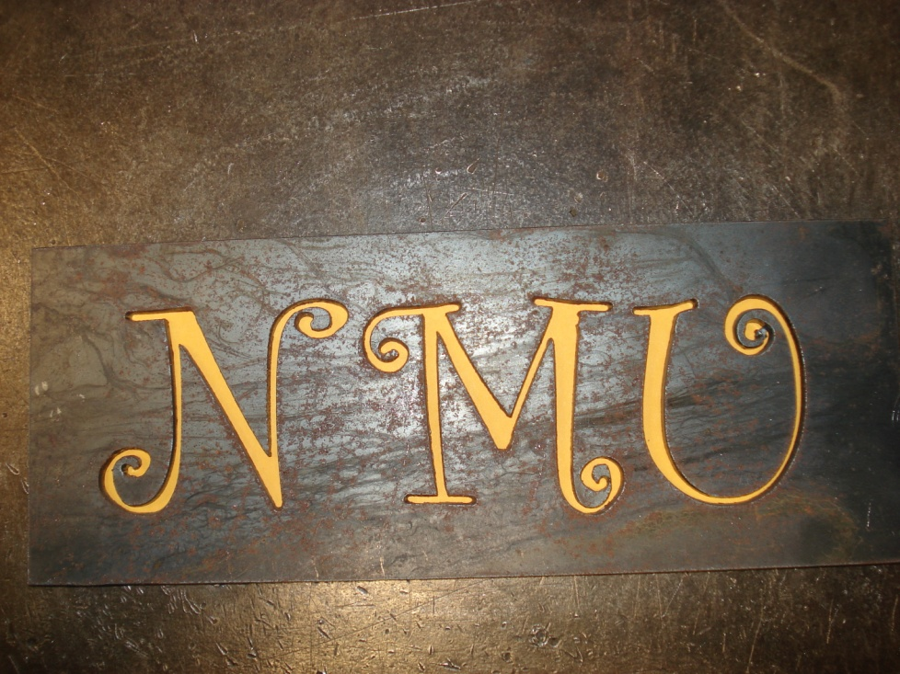
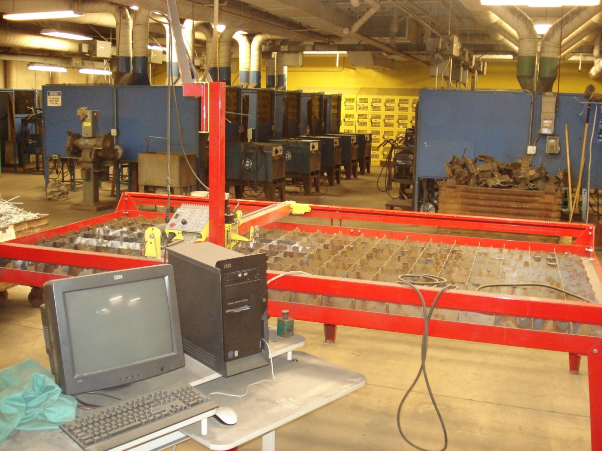
Industrial Maintenance / Welding Programs
5. Quality of Program Inputs and Resources
A new computer controlled plasma cutter was added in 2009.

Slide 12
Industrial Maintenance / Welding Programs
6. Quality of Program Outcomes
Graduates leave the University prepared to be successful maintenance mechanics and welders
CNR hired 20+ IM interns last summer
CNR has a minimum of 14 IM graduates in their employ
Welding program faculty have recently been contacted by Oldenburg Corporation; they wanted to know our maximum expected throughput of welding students.
Welding program graduates have a 90+% pass rate on multiple certification exams for the American Welding Society (AWS)

Slide 13
7. Size, Scope, and Productivity of the Program

Slide 14
Industrial Maintenance / Welding Programs
8. Revenue and other resources generated by the program
Enrollment of students (121) x tuition (8350) = $1,010,350 annually
9. Costs and other direct expenses associated with the program
Current Prop. (2-3 yrs) Prop. (3+ yrs)
Faculty including fringe = $98,131(1) $165,835(2) $135,408(2)
Adjuncts + fringe = $48,628 $24,314 $24,314
Lab materials and
consumables = $20,000 $20,000 $20,000
$166,759 $210,149 $179,721
Total increase for two new faculty after 3 years instead of one senior = $12,962

Slide 15
Industrial Maintenance / Welding Programs
10. Impact, Justification, and overall essentiality of the program
The program has a strong economic impact on the Universities’ revenue stream and fulfills the mission of the TOS department and NMU’s Community College role of providing good paying jobs with short term programs.
11. Opportunity analysis of the program
This program is well positioned to provide strong enrollments for NMU, job opportunities for many students and the ability to support businesses in the region with quality employees.
This enhancement position will also provide an opportunity to search for a cross-trained individual that will be available to assist in teaching classes in the HVACR (HV170) and Building Technology and Construction Management programs (CN278). This cross-trained approach will help the TOS department build in flexibility to handle possible future enrollment swings.
With the recent increased student numbers, welding lab usage has increased significantly and safety of students and lab equipment will be improved with additional full time personnel in the lab.

Slide 16
Industrial Maintenance / Welding Programs
Additional Considerations
Current annual loads
One full time faculty – 24 credits
Multiple adjuncts – 50 credits
MARESA welding class – 12.5 contact hours per week
One faculty member – 121 advisees
Recent cost reductions in the TOS department
Annual Savings
2009 – RIF a faculty position $84,250
2010 – RIF a faculty position $70,500
2010 – RIF a clerical position $52,600
Total $207,350
Now is the time to recoup a small (6%) portion of these savings and reallocate them to a growing program

Slide 17
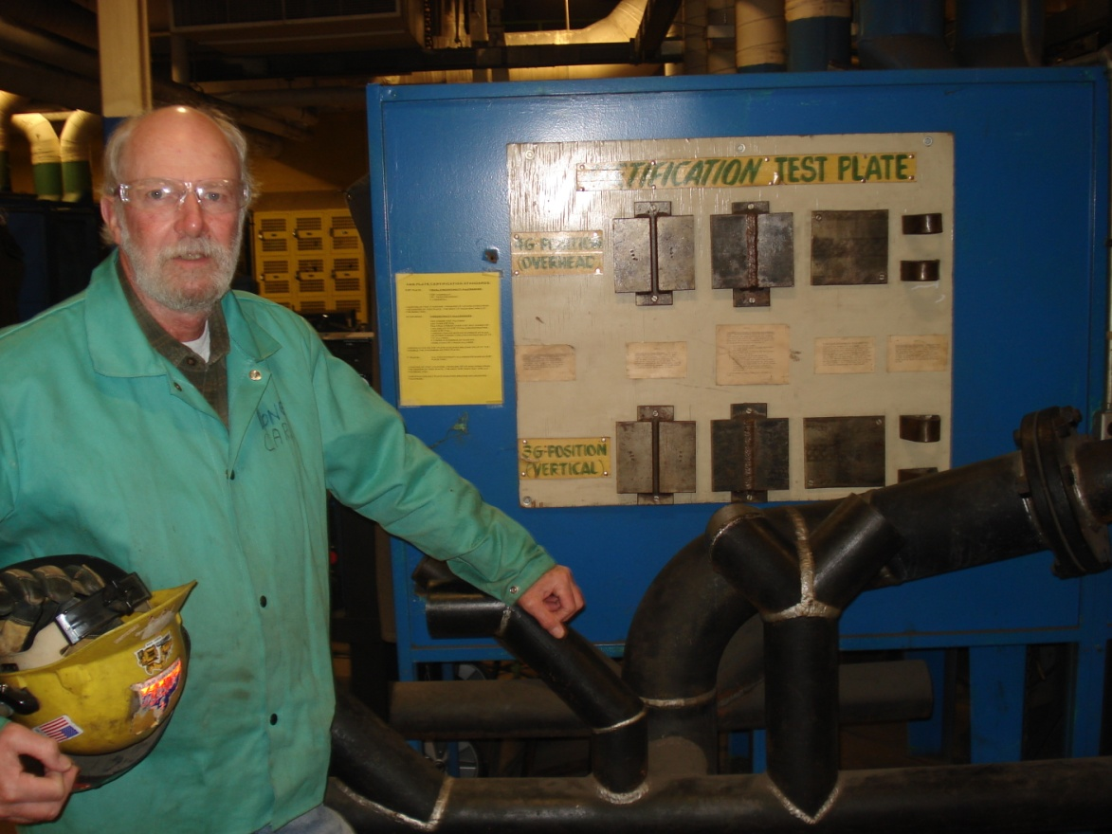
Industrial Maintenance / Welding Programs
Additional Considerations
Exit Strategy
The current lone faculty member has forecasted retirement in the next 2-3 years

Slide 18
Industrial Maintenance / Welding Programs
Additional Considerations
Exit Strategy
The current lone faculty member has forecasted retirement in the next 2-3 years
At that time, we will reassess the program
The newest faculty member will have received a 1-2 year mentorship of the program
Best case, the program will have stabilized or grown and a replacement for the retiring faculty member will be necessary
Worst case, the program will not have performed as expected and the position will not be replaced
Due to the nature of this specific enhancement, prompt approval of a search would be beneficial

Slide 19
To Recap
The TOS department must respond rapidly to industry needs
This enhancement request:
is not equivalent to a new $100,000 faculty line
$43,400 increase until Carl leaves, $12,962 from then on….
reflects a reallocation of resources within the TOS department
has an exit plan
should not wait for 21 months

Slide 20
Thank you for your time & support!

