Slide 1
Academic Information Services 2011 Update and Staffing Priorities
Educational Policy Committee
October 10, 2011

Slide 2
A Brief History
+ Olson Library
+ Instructional Media Services
+ Central UP & NMU Archives
+ Academic Computing Services
+ Instructional Technology & CITE
= AIS
Most of these changes transpired in late 1980s and early 1990s

Slide 3
Recent Changes
Instructional Media Services + Instructional Design, Technology & Media has now become Instructional Design & Technology (Dec. 2010)
Redefined two positions
Academic Computing Services – restructured; AIS now has Computing HelpDesk (July 2010)
Beaumier Heritage Center administratively under AIS, effective Oct. 3, 2011

Slide 4
AIS now consists of:
Beaumier Heritage Center
Computing HelpDesk
Instructional Design & Technology
Lydia Olson Library
Upper Peninsula & NMU Archives/Records
Collaborative relationships with Learning Resources Division (Audio-Visual), Information Services (formerly AdIT), Writing Center

Slide 5
AIS Mission Statements
AIS Mission Statement
Academic Information Services supports teaching, learning, scholarship, and community outreach activities by providing information resources, access to educational technology, and instructional services to help students and employees acquire information and technology skills that contribute to lifelong learning and productive citizenship. (Accepted by AIS Dean’s Advisory Council; 3/19/09)
AIS Unit Mission Statements
Archives – revised 3/19/09
Computing HelpDesk – revised 10/5/10
Instructional Design & Technology – revised 10/18/10
Lydia M. Olson Library – revised 3/19/09
Beaumier – (?)

Slide 6
Facilities: Learning Resources Center (LRC), Cohodas, and Services building
Beaumier Heritage Center located in Cohodas
LRC houses
Library (upper two floors)
Instructional Design & Technology, CITE (first floor)
Computing HelpDesk (first floor)
Archives (first floor)
Services building houses Records storage
Classrooms in LRC, including renovation of LRC 108 into an Active Learning Classroom (NSF grant)

Slide 7
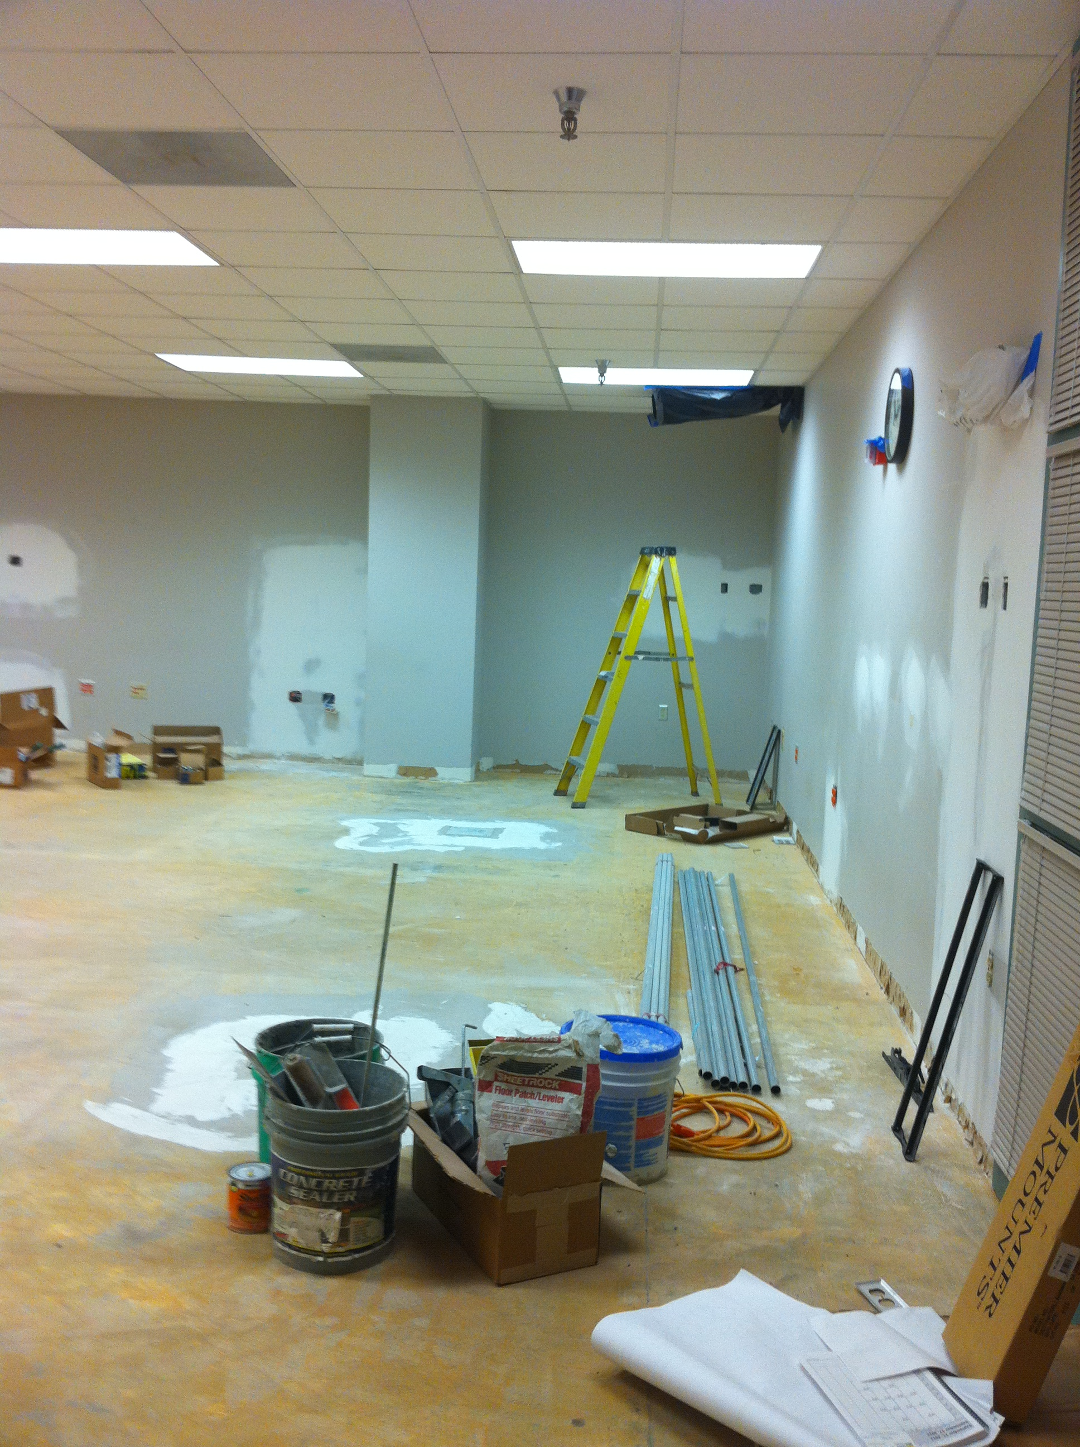

Slide 8
Recent staffing changes
IMS retirement – Instructional Media Supervisor revised to Instructional Technology Specialist, expanded support to CITE
Cataloging Librarian – revised to Metadata and Cataloging Services Librarian, expanded support to Archives
Positions eliminated/reduced due to budget reductions: 1 SA and 1 Post-MLS Fellow (faculty) lost; 1 Faculty reduced 12 to 9 month appointment; 2 TOP positions reduced

Slide 9
Align with Mission & Vision of Academic Affairs
Intellectual Foundation
Instructional services focus on critical thinking, problem-based learning
Liaisons with departments, English (EN111), FYE, Writing Center
Archives and Beaumier – cultural, historical, local & regional
EduCat, instructional technology
Active Learning
Credit courses complement broader curriculum (Liberal Studies, Public History)
Student-guided library tours, Archives & Beaumier projects
LRC 108 renovation and principal in NSF grant
Career Preparation
Student employment leading to graduate school or employment
Resources for exploring career options
Community Engagement
Connections to regional K-12, Charter Schools, Native American schools/libraries
Local library connections – Peter White Public Library
Archives – internships

Slide 10
EPC Criteria
Internal demand – Does AIS provide essential support for others in the University? Yes.
Quality of program inputs and resources
Equipment – maintained, updated, replaced (e.g. EduCat, software, digital resources equipment)
Facilities – recent improvements - Library group study; GU/DP classroom designations; connection to JXJ renovation
Faculty – expertise, engaged
Student Assistants - expectations of professionalism, customer service, cooperation

Slide 11
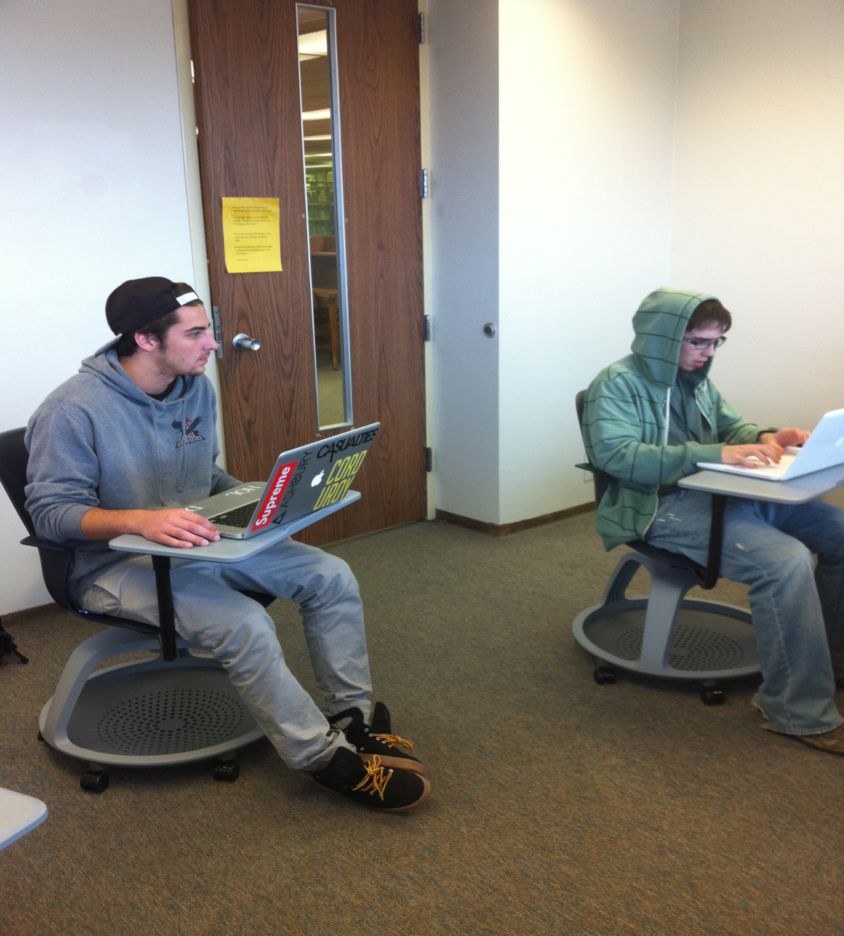
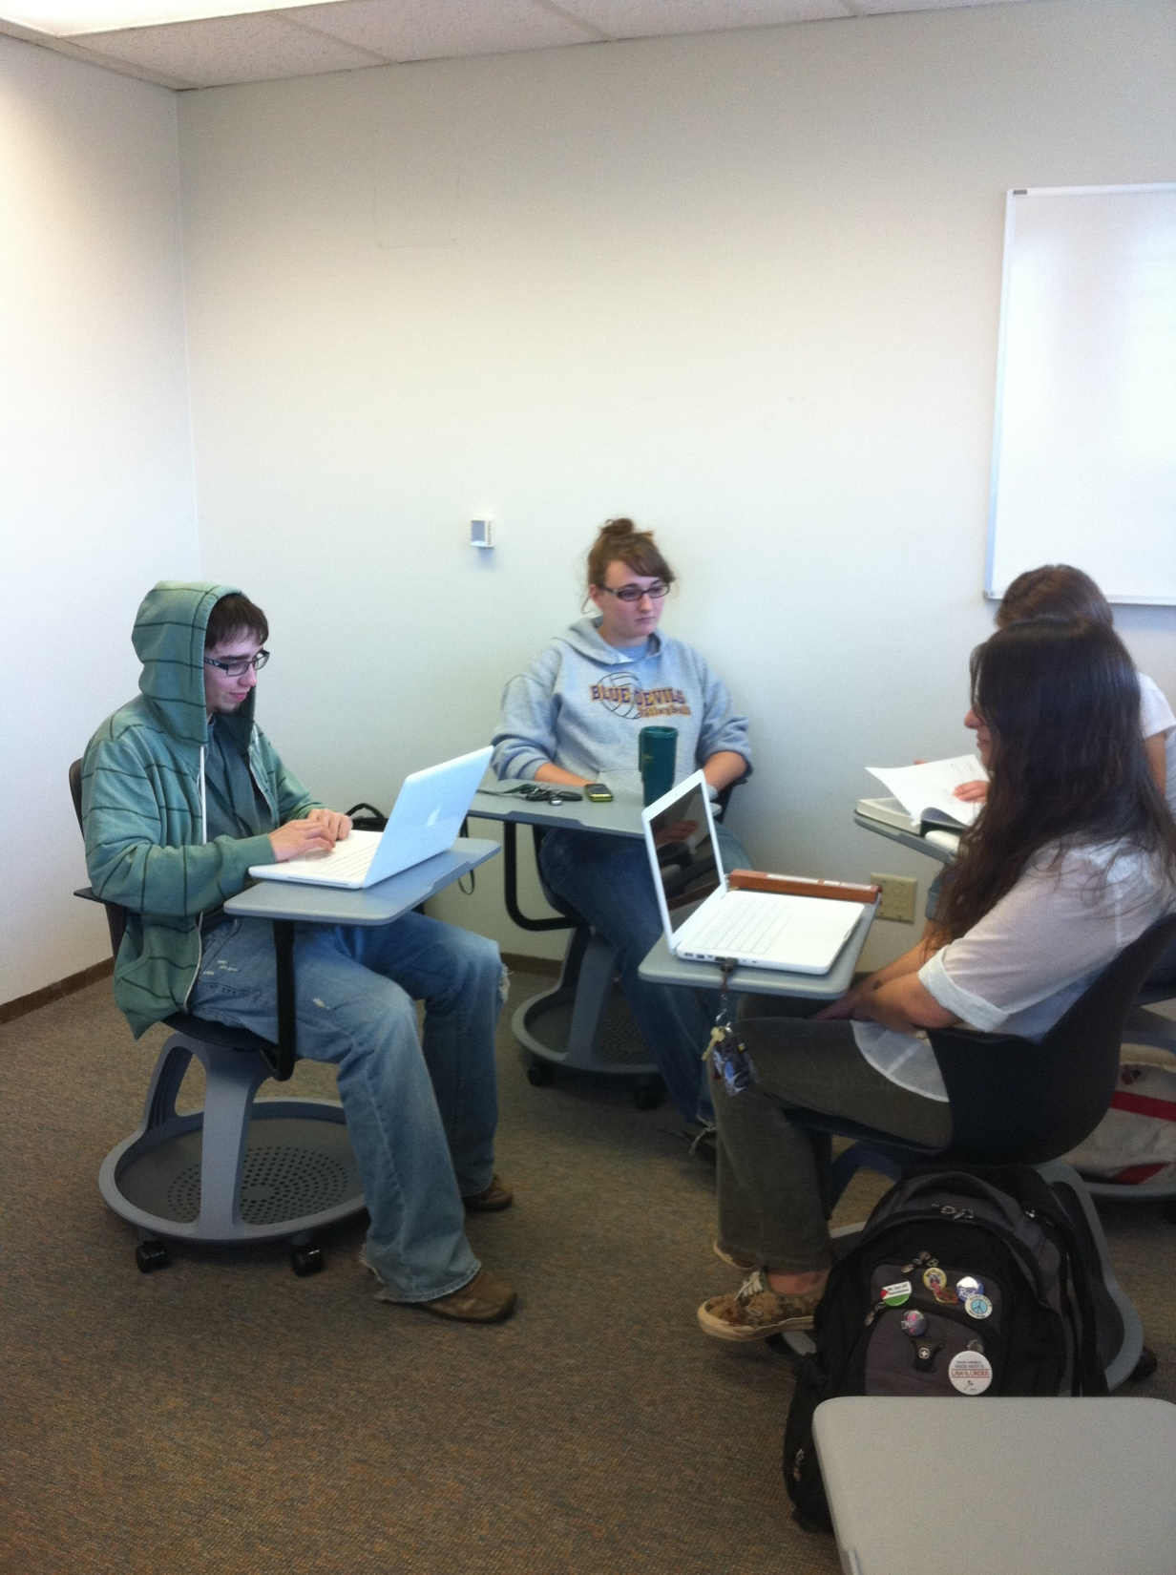

Slide 12
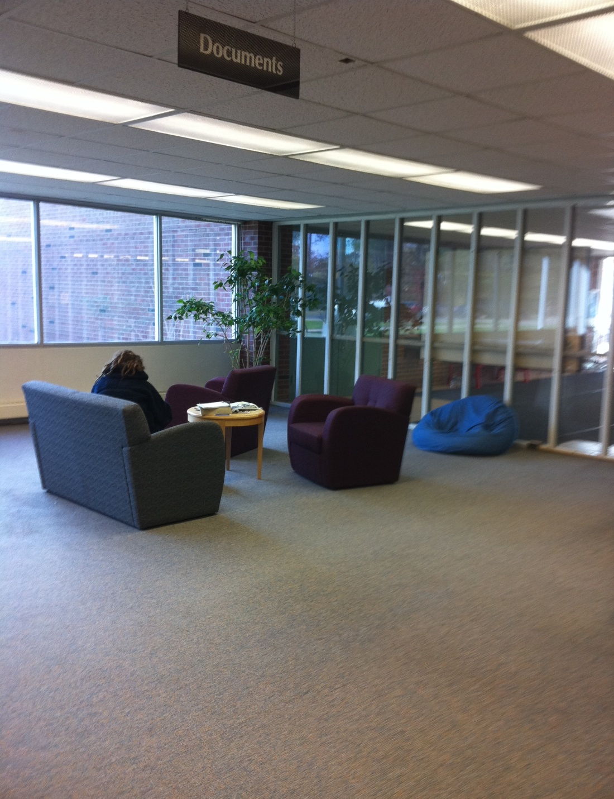
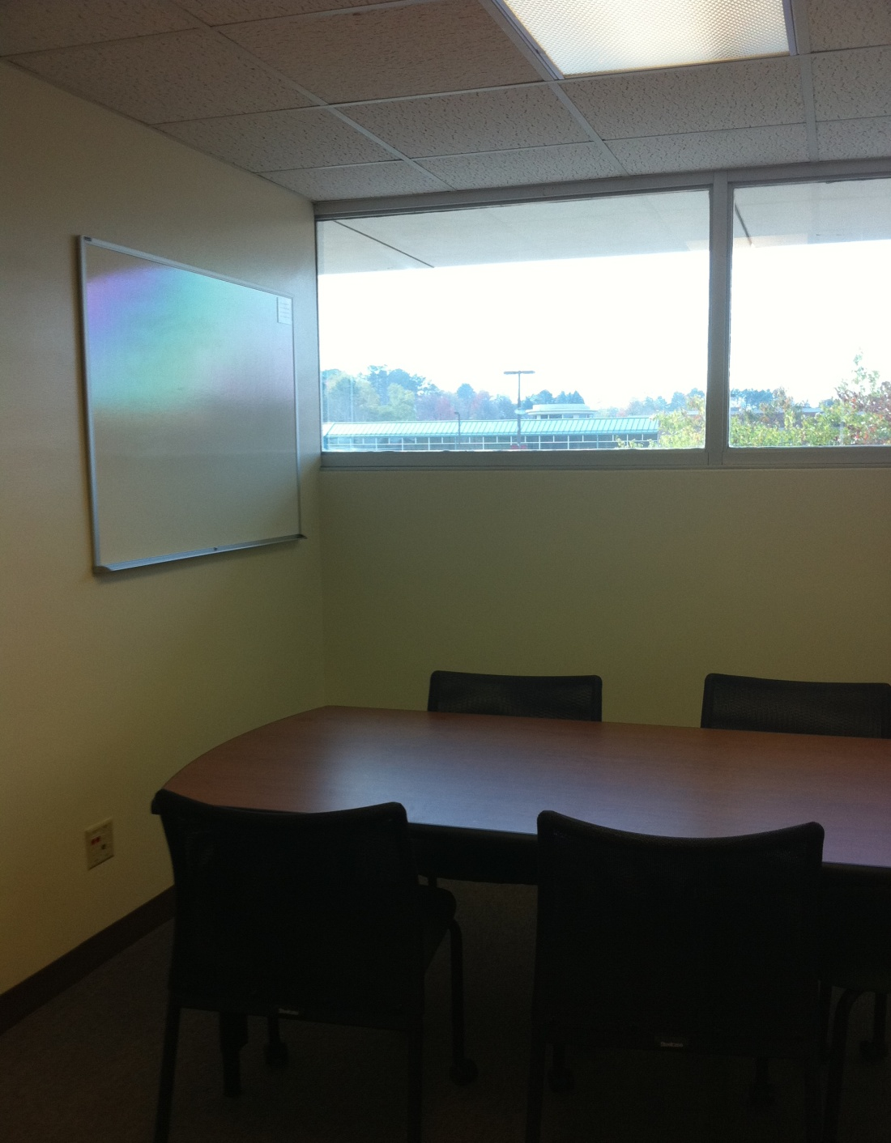
LRC Group Study Room
(includes white board and projection equipment)
LRC First Floor Study Area

Slide 13
Quality of program outcomes
Impact on regional community
Tribal libraries consultations
Geographic mapping for Peter White Public Library
MeL e-Library trainer for local libraries
Archives workshops on preserving local documents, family histories
Beaumier programming (museum, Folklife festival, International Performing Arts series, etc.)
Learning outcomes assessment
AIS 101 ongoing component of Library’s assessment
Embedded librarians in EduCat within AQIP plan

Slide 14
Size, scope, and productivity of the programs
Library measures as reported in Academic Library Survey (formerly IPEDS) (FYES: FTETF Library Fac is 981:1)
Archives collections and acquisitions – political, economic, government records and papers
Computing HelpDesk questions exceeded 27,600 for FY11
Instructional Design & Technology – EduCat requests exceeded 1,000 in Fall 2011 semester; over 300 teaching staff (faculty, TAs, contingent faculty, etc.)
Embedded librarians – Fall 2011 approximately 80 courses;
Library Instruction January – August 2011 for 184 sections with 3,993 students (2010 = 142/3,072)

Slide 15
Revenue and other resources
Revenue
Library system consortium host (LSSU, Gogebic, Finlandia)
Better World Books for withdrawn library books (69% to BWB)
Grants
Archives
Wildcat Innovation + Marquette City + Marquette County ($45,000)
NHPRC grant for CCI Records ($69,000) in year two assessment
Nat’l. Historical Preservation & Records Commission ($225,000)
(pending 3-year project for electronic archives)
Instructional Design & Technology
NSF grant partnering with STEM disciplines ($159,000)
Library
MI partner is LSTA grants for digital resources ($250,000+)

Slide 16
Costs, expenses, and efficiencies
$3.5 million general fund
Established labor, student labor
Library Acquisitions
Equipment & computer systems
External partnerships (OCLC, MeL, Endeavor, etc.)
Efficiencies and cost cutting
Shared purchasing through Midwest Consortium Library Services
Open source software adoption (e.g., EduCat, Shiboleth, etc.)
Access rather than ownership
Combined service points
Digital instructional tools for EN 111, UN100

Slide 17
Five Library Strategic Directions
Continue the migration from print to electronic collections and capture the efficiencies made possible by this change.
Retire legacy print collections while maintaining discipline-based core titles and preserving access to resources.
Redevelop the library as the primary informal learning space on campus and continue to develop partnerships with other campus units that support research, teaching, and learning.
Reposition library expertise, resources, and information tools so they are embedded into the teaching, learning, scholarship, and research enterprises.
Migrate from purchasing materials to curating content.
Based on David W. Lewis, “A Strategy for Academic Libraries in the First Quarter of the 21st Century,” College & Research Libraries (2007)

Slide 18
AIS New Positions - Reallocations
Priority 1 – Instructional Technologist (AP7)
Top priority for past 4 years in AIS staffing plans
Growth in use of course management system
Assist faculty with design and construction of web-enhanced, hybrid (blended), online courses and programs
Design team environment
Exploration of emerging technologies
Support for students using web-based learning tools

Slide 19
AIS New Positions - Reallocations
Priority 2 – Archives/Records Management Specialist (anticipated to be AP4)
Ranked as 2nd or 3rd priority in last 4 years staffing plan
Support required for NMU records retention & destruction, both print and electronic (350-400 cubic feet of print material annually using 350 state approved retention schedules)
Assist with NMU institutional repository

Slide 20
AIS New Positions - Reallocation
Priority 3 – We have a tie:
Documentation & Web Support (anticipated to be AP5)
Ranked 3rd or 4th in past 4 AIS staffing plans
Support for Library, HelpDesk, and Instructional Design and Technology
Instructions, policies, procedures for communicating the potential, the limitations, and the legal obligations of resources, software, hardware, network applications used campus-wide for classes, research, and presentations
Web-based and mobile
Reinstate the Post-MLS Fellow position – recommended by EPC previously and lost in last round of budget reductions

Slide 21
Conclusion
Staffing positions are one of the building blocks in a process to sustain and enhance the most appropriate, productive, and effective AIS services (i.e. programs)
Also in the works:
A 2-year fiscal plan for Library acquisitions that is consistent with the 5-year strategic plan
Active learning workshops, high-tech interactive classroom
Connection to JXJ, including plans to relocate Archives onto the LRC 3rd floor and create additional classroom space near technology support
Analysis of Library’s Holocaust collection (strengths, directions)
Development of student technology support, similar to CITE for faculty
Increased involvement with embedded librarianship; assessment of learning when using different delivery methods (F2F, hybrid, embedded)
Investigation of providing HelpDesk and basic Archives support at the Library’s Public Services desk to expand coverage without increased overhead

