Slide 1
Let’s work together to get students connected.
You have the opportunity to serve a critical role in student retention by getting students connected with vital campus resources.
When students use resources, they learn to help themselves and can be more successful both in and out of the classroom.

Slide 2
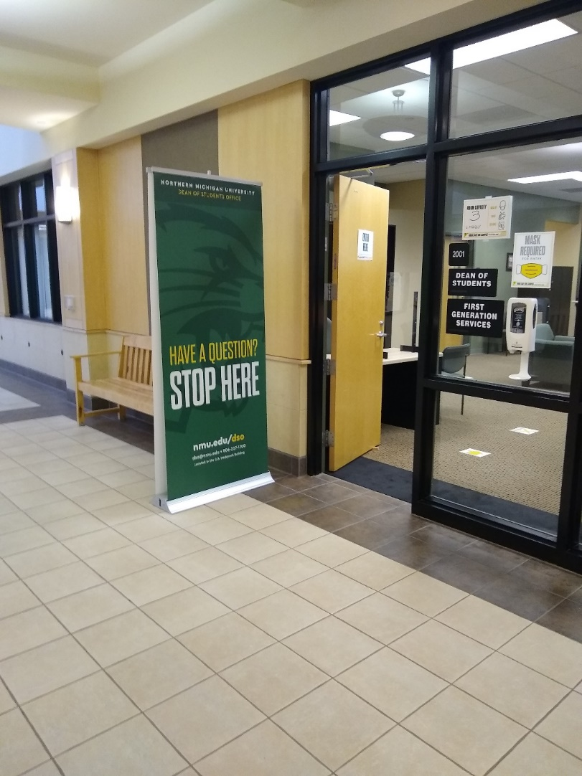
Dean of Students Office
If you’re unsure where to go, what to ask, or who to talk to, start at the Dean of Students Office, located on the main floor of the Hedgcock building. Open 7:30 - 4:00 Monday through Friday
Email: dso@nmu.edu
Ph: 906-227-1700

Slide 3
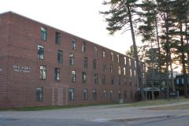
NMU Health Center
The NMU Health Center and pharmacy are located in Gries Hall.
Please call 906-227-2355 to schedule an appointment.
All visits require an appointment. As of 8/10/2021 for all visits, regardless of vaccination status, you are REQUIRED to wear a mask.
There are two doctors (one male one female) and a nurse practitioner in addition to three registered nurses.
The NMU Pharmacy can fill many prescriptions.

Slide 4
Counseling and Consultative Services
Counseling services at NMU are free for all enrolled students. No insurance or other coverage is required. The office is located on the top floor of C.B. Hedgcock in Room 3405. Counseling and psychological services are offered that facilitate students' personal development to participate more successfully in the NMU living and learning community.
Phone: (906) 227-2980 Email: ccs@nmu.edu

Slide 5
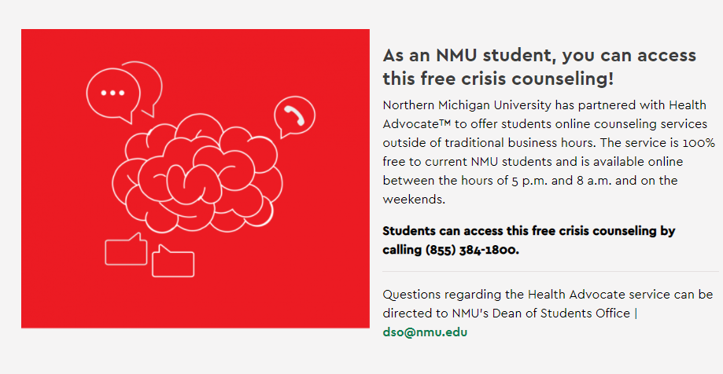
After Hours Counseling

Slide 6
DIAL HELP is available 24/7 for free, confidential, non-judgmental services for crisis support, crisis intervention, mental health, and referral services.
DIAL HELP has live counselors who will talk, text, or chat with you ANY TIME of day or night.

Slide 7
Take Charge of Your Mental Health
Schedule Time for Wellness
Make physical activity, stress management, and healthy eating a structured part of your day
Build Coping Skills
Practice gratitude, mindfulness, deep breathing, and positivity
Know Available Resources
Familiarize yourself with:
NMU Health Center and Counseling and Consultation Services
After hours (4 pm – 7:30 am) and weekend counseling provided by licensed counselors via Health Advocate
Local and self-help resources linked on the Counseling website, including TAO (Therapy Assistance Online) and 24/7 support and crisis services like Dial HELP
Develop Your Support System
Get involved on campus, meet new people, spend time connecting with family and friends
Get Timely Help
If your thoughts or emotions are impacting your ability to concentrate or function, seek help right away
Adapted from “5 to Thrive” Mental Health Checklist for College Students by The Ohio State University

Slide 8
NMU Food Pantry
The NMU Food Pantry is located in Gries Hall, above the NMU Health Center. It is open every week.
Non-perishable food and kitchen items are available.
Personal care items including feminine hygiene products, bedding, and towels may also be available.
www.nmu.edu/dso/nmu-food-pantry
nmu_food_pantry

Slide 10
Veteran Services
NMU has dedicated, trained staff here to assist you in processing your Veteran Administration Educational Benefits.
You may stop in or schedule an appointment to meet with a veteran representative.
2101D Hedgcock
906-227-1402 mrutledg@nmu.edu
Mike Rutledge and Welles

Slide 11
Disability Services
Provides services and reasonable accommodations to students with disabilities so they may have an equal educational opportunity.
Collaborates with students and review documentation to determine the eligibility of appropriate and reasonable accommodations at a post-secondary level.
Assists in arranging course, classroom, and testing accommodations.
Helps students develop self-advocacy skills and confidence to take responsibility for their academic success.
Facilitates university compliance with federal legislation.
Promotes campus awareness regarding disability issues.
2101 Hedgcock Phone: 906-227-1737
E-mail: disserv@nmu.edu

Slide 12
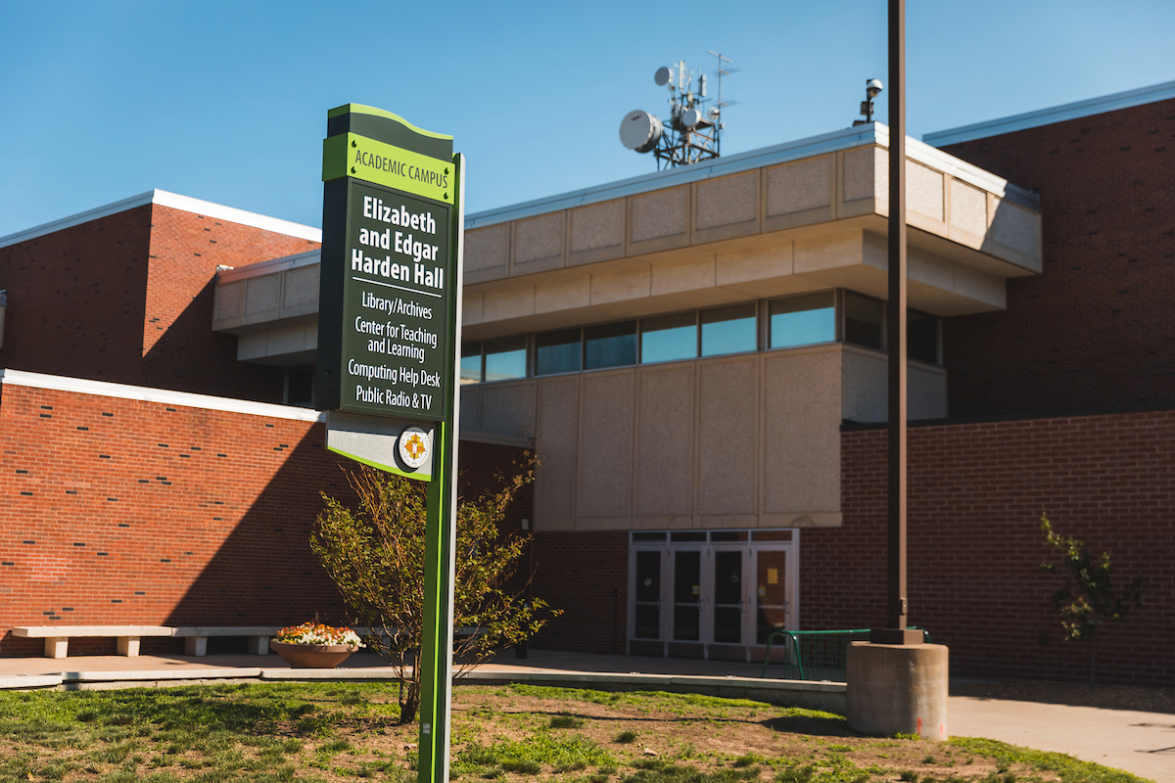
NMU Library
The Lydia M. Olson Library is committed to meeting the needs of NMU’s students, faculty, staff, and community.
They are constantly improving traditional library services, supporting student success and retention, expanding opportunities to engage students in cutting-edge technology, and improving community access to regional history.
library@nmu.edu

Slide 13
All Campus Tutoring
FREE FOR ALL STUDENTS
Locations: Harden Hall Basement 111H (Behind Fieras)
The Woods 104B Maple West (near the desk) Jacobetti Complex (tutorjco@nmu.edu)
Stay up-to-date visit: www.nmu.edu/tutoring

Slide 14
Northern Michigan University has partnered with Knack to help strengthen the peer learning community on campus! As an NMU student you can use Knack to get help from a fellow peer that already aced your class, and/or sign up as a Knack Tutor to help your peers in classes you have aced.
How it works
1
Submit a request and review qualified tutors.
2
Select your tutor and schedule a session.
3
Meet with your tutor and Knack it out of the park!

Slide 15
NMU Writing Center
The Writing Center works to promote clear, effective written communication.
The highly trained peer tutors help members of the NMU community improve their writing skills through free, one-on-one consultations and online tutorials.
Both in-person and online tutoring are offered.
Harden Hall 111G (Lower floor of the library)
Our summer hours run concurrently with Summer Sessions I and II (typically mid-May through mid-August).

