Slide 1
Major/Minor Combinations Incorporating Physics.
You probably didn’t think of these!!

Slide 2
Some of these might pertain to you!
Interested in physics (or sciences in general)?
Don’t want to be a physicist but want to utilize physics in a career?
Do you know how to write well?
Do you have a creative/entreprenuerial mind?
Interested in being in the courtroom?
Interested in a Master’s or PhD program in physics, health physics, meteorology, health physics or many other physics related fields?
Any or all of the above?

Slide 3
Consider the following!
Major in physics, minor in English/writing or journalism.
Major in physics, minor in business/entrepreneurship.
Major in physics with a pre-law emphasis and a political science minor.
Reverse any of the above!
It’s important to get more women into the career.
Of course, you can also go to graduate school in many different areas of science or engineering with a physics major.

Slide 4
Employment Opportunities
Private industry, publishing industry….can use people with a science background interested in technical writing.
If you want to create your own private business based on the development of a product, physics is a good background to have.
Law schools are deficient in students who are trained in scientific areas and love having such students apply to become patent or civil/criminal lawyers.
Use your own imagination….Physics is VERY flexible!

Slide 5
NMU PHYSICS
Small department with great faculty accessibility.
Active Physics Club.
Annual trip to Argonne National Laboratory.
Research opportunities in low-energy nuclear spectroscopy and beginning astronomy and possibilities in high energy physics/neutron studies.
Great facilities, including a very nice office for all our majors.
We help our students!

Slide 6
NMU PHYSICS FACULTY
Dr. David Lucas (Head) PhD from Michigan Tech U.
Dr. David Donovan PhD from Penn State U.
Dr. Mark Jacobs PhD from Stanford U.
Dr. Neil Russell PhD from Indiana U.
Dr. Will Tireman PhD from Kent State U.
Please contact Dr. Lucas (906)-227-2191 or dlucas@nmu.edu for more information.

Slide 7
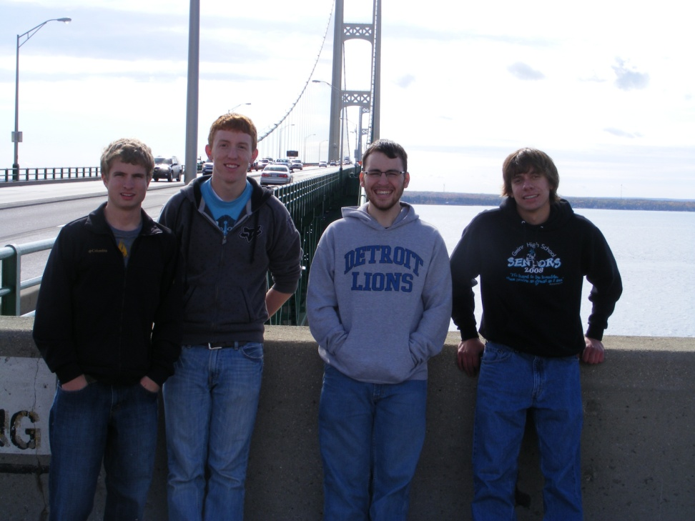
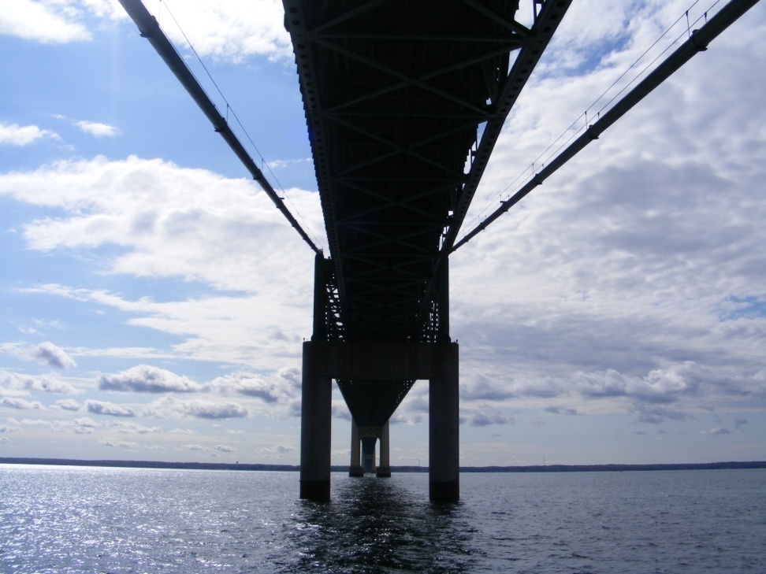
Physics Club Mackinac Bridge Tour

Slide 8
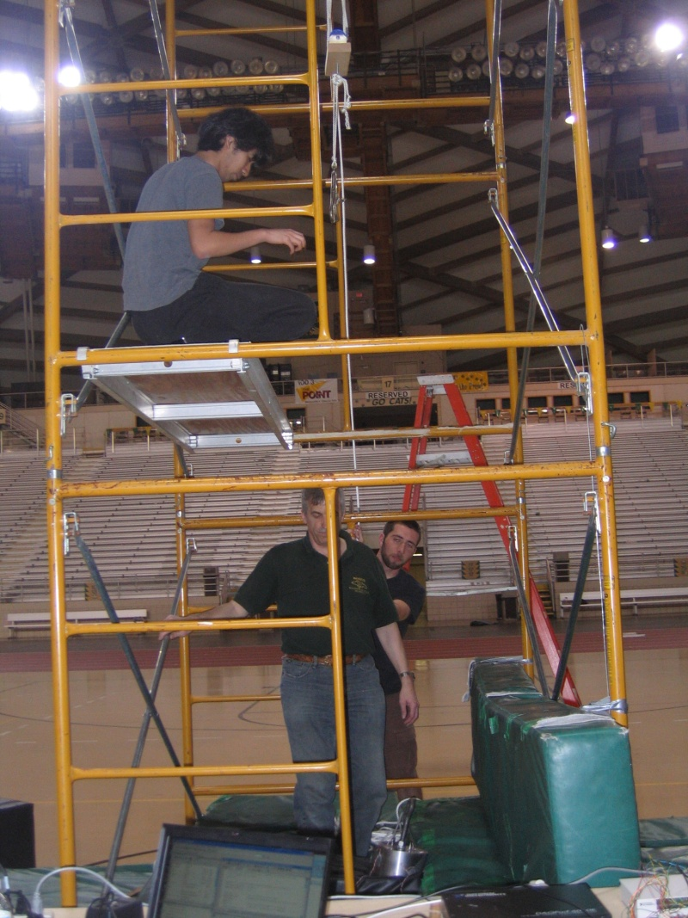
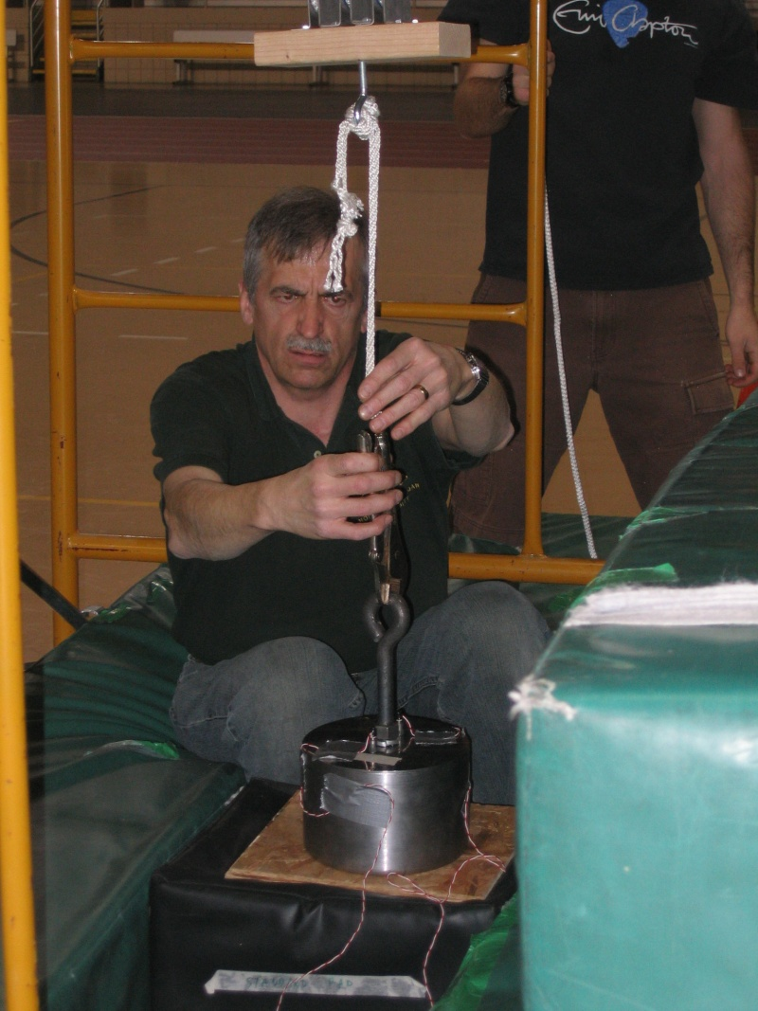
NMU Physics Tests Speed Skating Pads for the USOEC

Slide 9
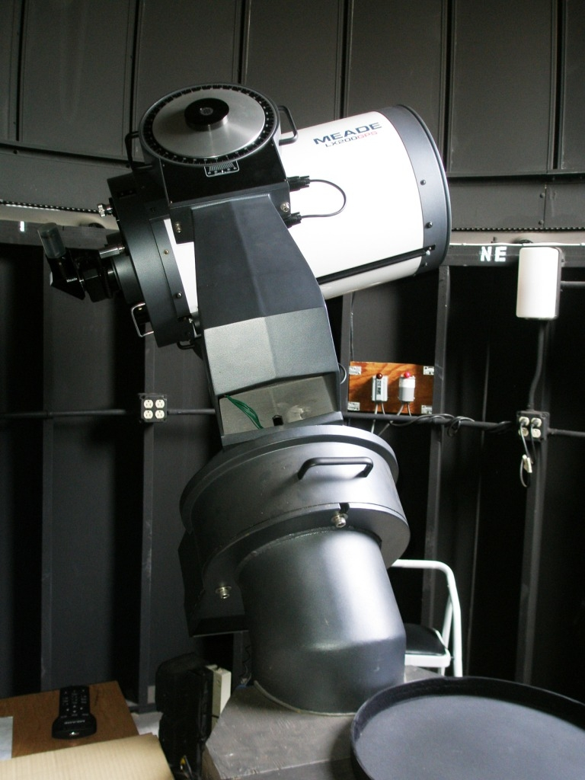
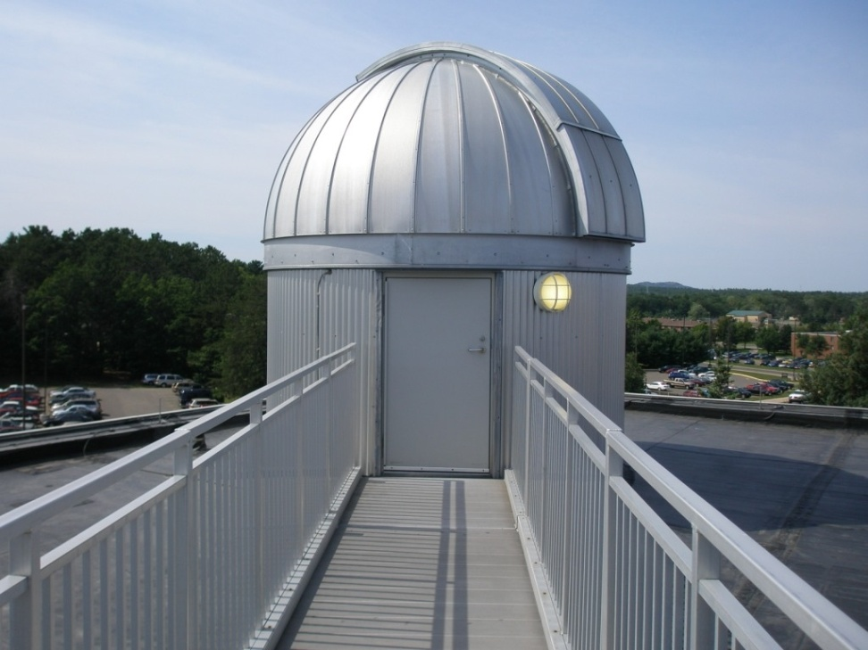
NMU Observatory

Slide 10
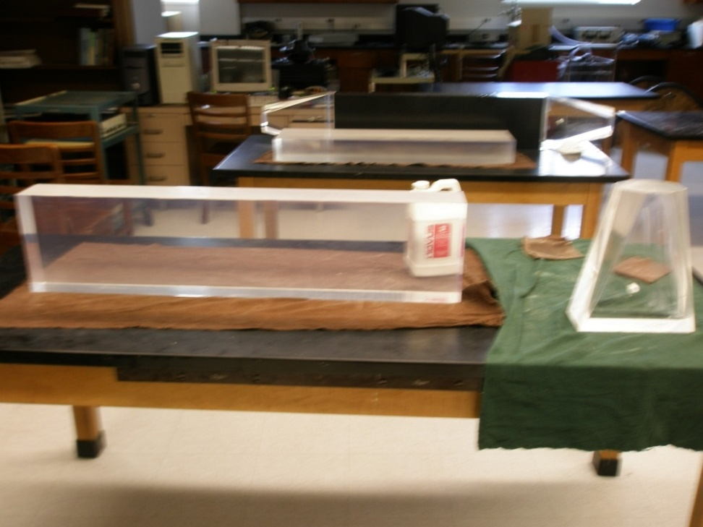
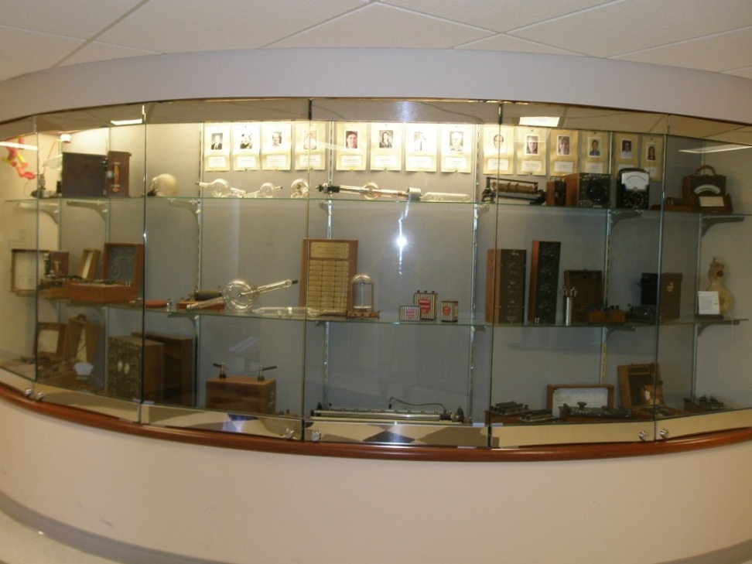
Neutron Detectors for J-lab (left)
Department museum display (right)

Slide 11
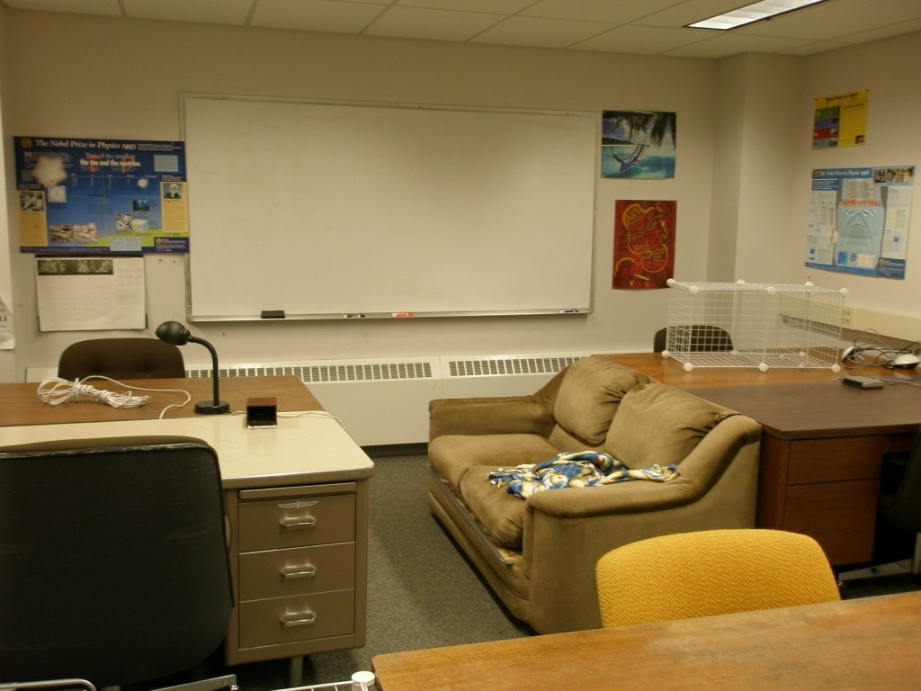
NMU Physics Major Office

Slide 12
Contact Information
Highly recommend a campus visit.
NMU Admissions (906-227-2650)
NMU Physics
Dr. David Lucas
906-227-2191
dlucas@nmu.edu

